Slide 1


Slide 2

The Achievements of EU Public Procurement Directives
Professor Christopher Bovis FRSA

Slide 3
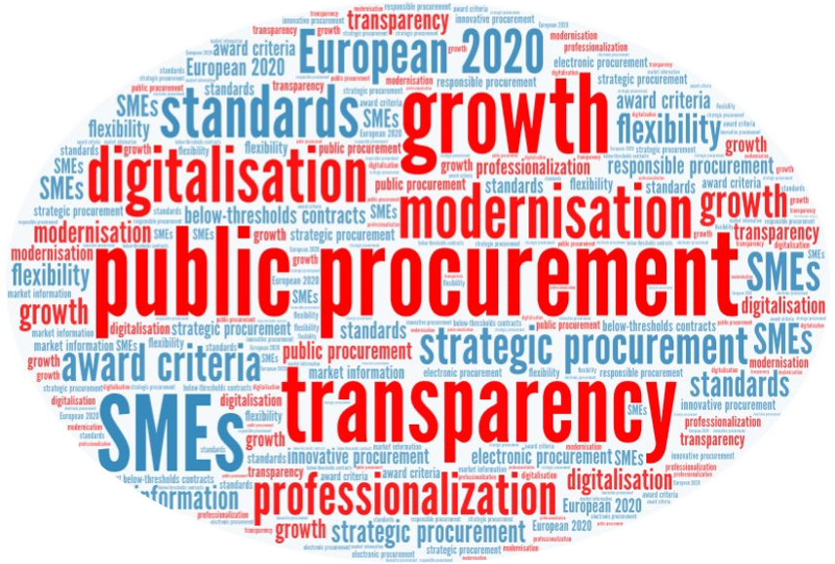

Slide 4
2014 EU Procurement Reforms: The Objectives
Simplicity (codification, modernisation and non-exhaustive harmonisation)
Strategic (EU 2020 Growth Strategy, ESFI)
Access for SMEs (dimensional / sub-dimensional)
Flexibility (In-House, Innovation, Green, Sustainable, Socio-economic, SGEI)
Governance (probity, professionalisation of procurers)

Slide 5
Achievements
Porosity cured by Concessions Directive covering supplies, works and Services
Dimensionality (below threshold procurement)
Acceptance of Judicial Activism for internalisation (In-house), dualism, award criteria (environment, socio-economic), selection & qualification (exclusion)
Decoupling in competitive markets (telecommunications)
Cross-fertilisation/implants, affiliation + in house, frameworks,
Flexiblity, lots, discretionary exclusions,
Correction, self-cleaning, price abnormality
Competition, FSR
Automation, ESPD
Acquis Balance, Soft Law

Slide 6
Strategic Procurement
Available tools
Pre Procurement Engagement
    Market consultation and pre-commercial procurement
    Joint and cross-border procurement
    Division into lots / disaggregation
  Selection and Qualification
    Financial and economic standing = Value/turnover ratio
    Technical specifications = functional and performance-based specifications

Slide 7
  Award procedures
    Competitive dialogue, negotiations, frameworks, Innovation Partnership
  Award criteria
    BPQR and MEAT for environmental and social criteria and innovative characteristics
    LCC
  Post procurement Engagement
    Contract Performance
    Social and environmental considerations

Slide 8
Barriers and Obstacles to Strategic Public Procurement
Specifications
Standards (efficacy of CPV)
Qualification
Economic standing of SMEs (risk ratio)
Award criteria
Cost based criteria (lowest price)
MEAT and now BPQR
LCC (methodology)

Slide 9
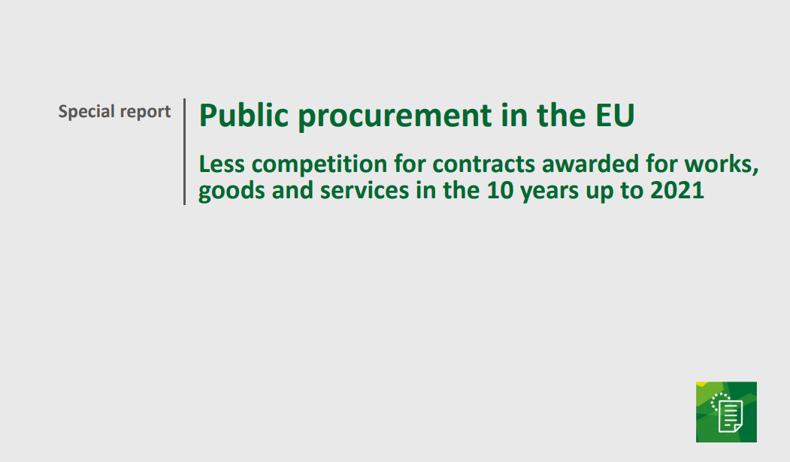
European Court of Auditors report 2023
Integrity and transparency are still a challenge
62 As public procurement involves large amounts of public money, there is a risk for fraud and corruption. Transparency in public procurement is therefore crucial not only to allow processes and decisions to be monitored and controlled but also to ensure that decision-makers are held accountable. It also contributes to open public procurement and thus competition. The high number of often small contracting authorities, mostly at regional or local level, represents a considerable challenge to ensure the integrity and transparency. This is particular the case as small public contracts are often awarded directly.
63 In the Scoreboard, transparency is measured in terms of each member state’s publication rate, which corresponds to the value of public procurement’s contracts advertised on TED as a proportion of national gross domestic product. A higher publication rate indicates that more procurement procedures were conducted in a competitive manner, as well as greater transparency.
64 However, data shows that more than half of the EU-27 member states had consistently had an unsatisfactory publication rate below 5 %, the red-flag value shown on the Scoreboard, during the 2011 to 2021 period, and our trend analysis does not show any improvement over time. The survey results also demonstrate a lack of awareness on the issue with more that 43 % of respondents not monitoring this indicator

Slide 10
Indicators of Single Market Scoarboard
[1] Single bidder | ≤ 10% | > 20%
[2] No calls for bids | ≤ 5% | ≥ 10%
[3] Publication rate | > 5% | < 2.5%
[4] Cooperative procurement | ≥ 10% | < 10%
[5] Award criteria | ≤ 80% | > 80%
[6] Decision speed | ≤ 120 days | > 120 days
[7] SME contractors | > 60% | < 45%
[8] SME bids | > 80% | < 60%
[9] Procedures divided into lots | > 40% | < 25%
[10] Missing calls for bids | ≤ 3% | > 3%
[11] Missing seller registration numbers | ≤ 3% | > 3%
[12] Missing buyer registration numbers | ≤ 3% | > 3%

Slide 11
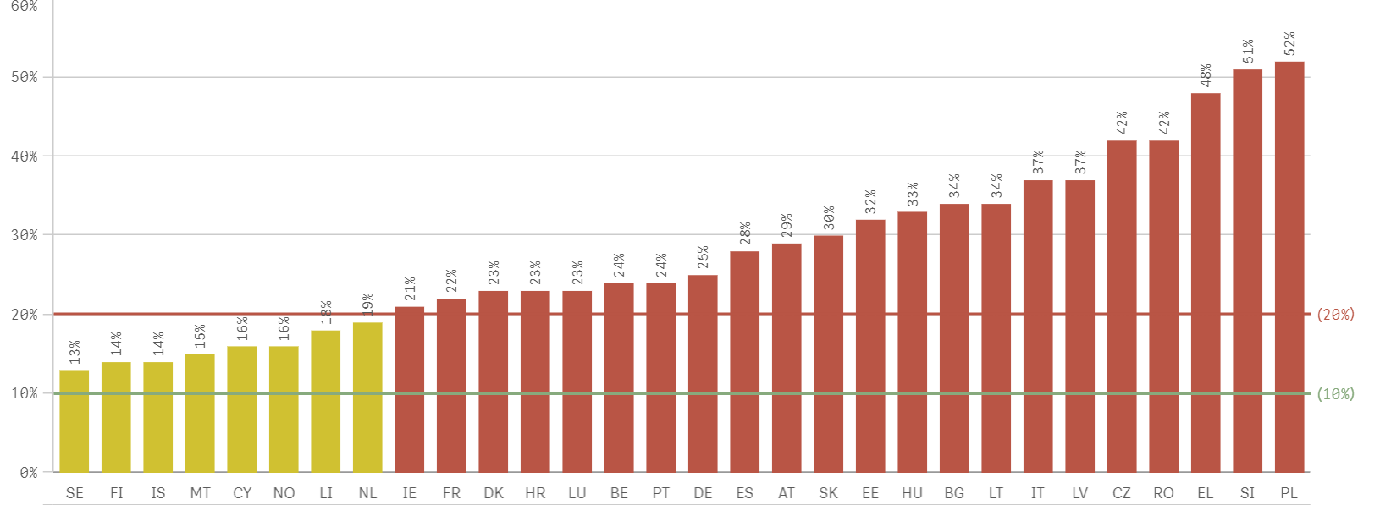
Single bidder

Slide 12
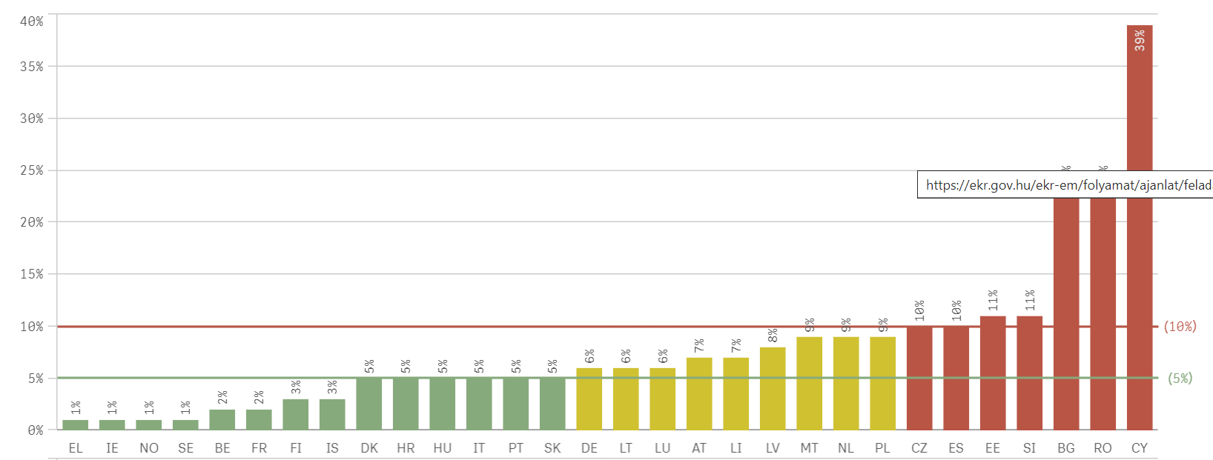
Direct awards

Slide 13
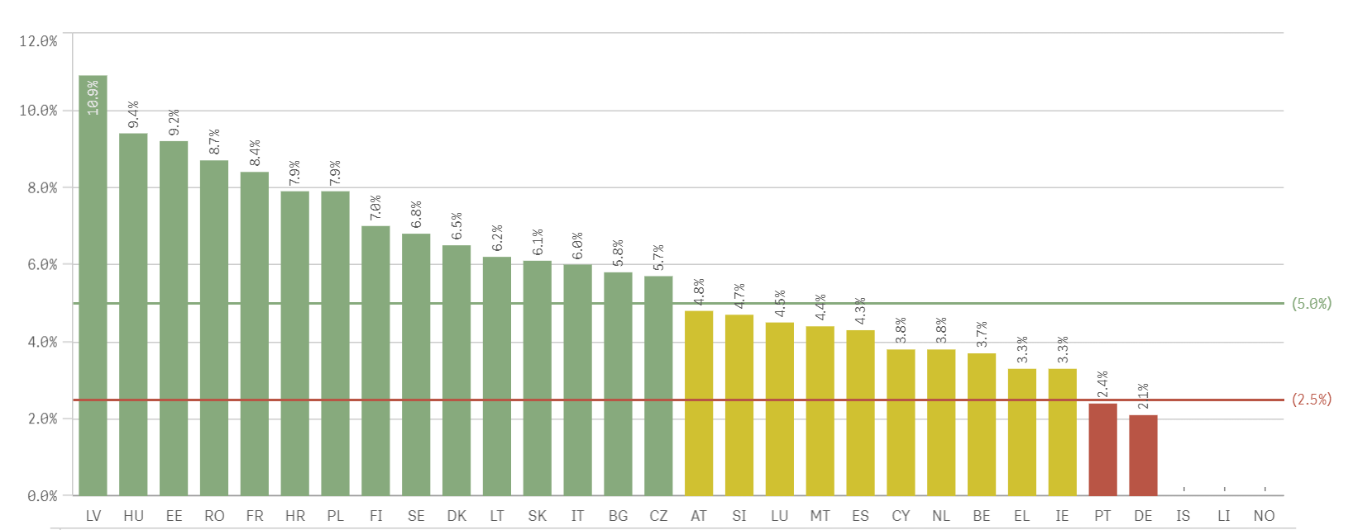
Publication value/GDP

Slide 14
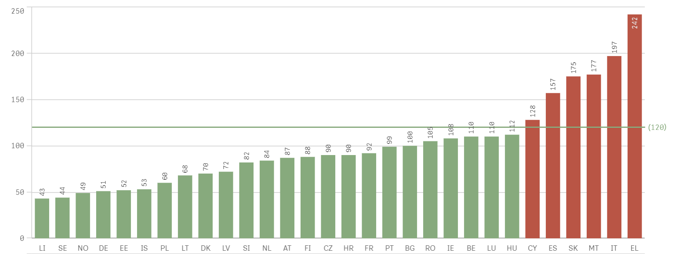
Decision speed

Slide 15
Final remarks
Price vs cost – conceptual foundation of strategic procurement
Remedies Directive Reforms Overdue
Soft Law crucial in assisting effectiveness of acquis

